Slide 1

An Accessible Open-Source Implementation of the Congruent Matching Cells Algorithms for Cartridge Case Analysis
11:05-11:20 D38
Joseph Zemmels, Susan Vanderplas, Heike Hofmann

Slide 2
Overview
Cartridge case analysis
What are algorithms?
The Congruent Matching Cells (CMC) algorithms
The cmcR package
CMC pipeline experimentation

Slide 3
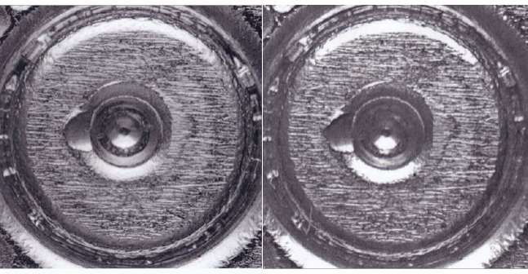
Cartridge Case Analysis
Notes:
I’m sure everyone in the audience is well-aware of cartridge case analysis.
However, to make sure we’re all on the same page

Slide 4
What are Algorithms?
Algorithm: A set of instructions used to perform a computation.
Computers can execute algorithms quickly and precisely.
Can be used to measure the similarity between pieces of evidence.
Evidence A
Comparison of Evidence
Measure of Similarity
Evidence B
Notes:
For cartridge case analysis, the standard “pipeline” goes something like what is shown on the bottom of the slide.

Slide 5
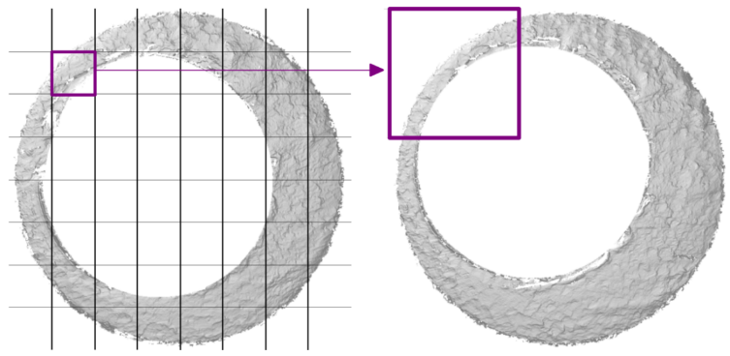
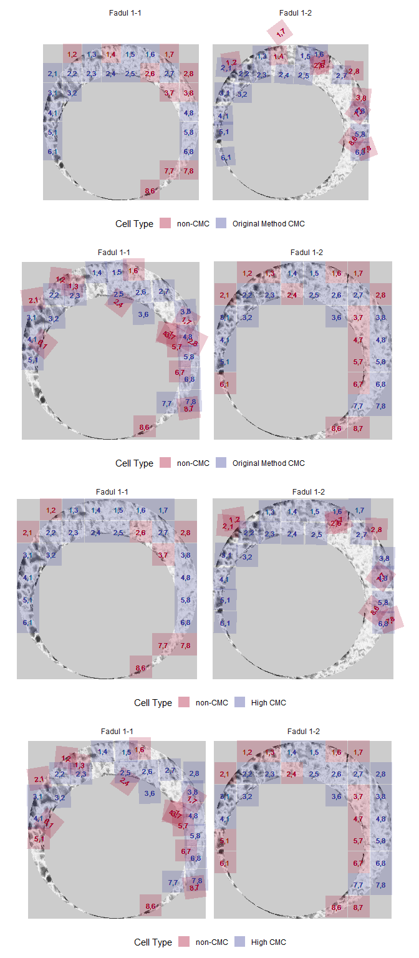
The Congruent Matching Cells Algorithms
Algorithms to compare cartridge cases based on breech face impressions.
Pre-process two cartridge case scans to highlight breech face impressions.
Divide one scan into a grid of “cells.”
Compare each cell to another cartridge case.
Classify cells as “congruent matching” if they match the other scan.
Measure similarity as the total number of “Congruent Matching Cells” (CMCs).

Slide 6
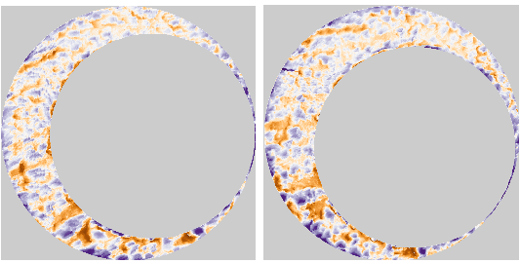

The CMC algorithms as a data-to-results pipeline
Each step can be thought of as a piece of an overall pipeline.
Evidence enters the pipeline, and a similarity score is output.
These steps can be further modularized into sub-steps.
Initial Data
Pre-processing
Comparison
Final Results

Slide 7
The cmcR package
Written open-source in the R statistical programming language.
Modularizes the CMC pipeline into single-purpose pieces.
These pieces can be connected via “piping,” %>%:
Initial Data %>% First Function %>% Second Function %>% ...
Allows the user to create their own version of the pipeline.
Enables experimentation, comprehension, and reproducibility.

Slide 8
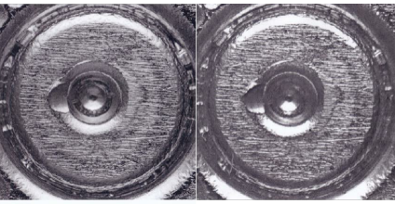
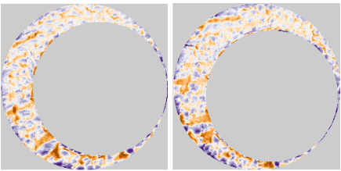

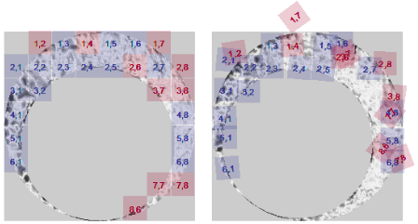
cmcR *Pipe*line
Initial Data %>%
Pre-processing %>%
Comparison %>%
Final Results
preProcess_crop() %>%
Cartridge Cases %>%
preProcess_removeTrend() %>%
comparison_allTogether() %>%
decision_CMC()
preProcess_gaussFilter() %>%
Notes:
On this slide, we have the same pipeline as introduced in the previous slides.
In cmcR, we have taken each part of this pipeline and broken them up into individual pieces, represented by the text in the middle of the slide.
First, we start with two cartridge cases, as shown in gray.
These cartridge cases are sent (represented by the pipe symbol)
Then, we perform some pre-processing on scans of those cartridge cases, as shown in orange.
We have divided this pre-processing stage into 3 steps which I won’t discuss due to time.
The result of the pre-processing is shown at the bottom of the slide.
Next, the scans are compared to each other, as represented in purple.
The comparison procedure is implemented in a function called comparison_allTogether().
Finally, the data obtained from the comparison procedure is sent to the Final Results stage in which particular cells are classified as “Congruent Matching Cells” or not.
The diagram at the bottom shows the final

Slide 9
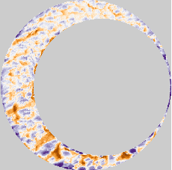
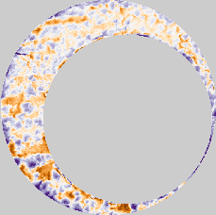
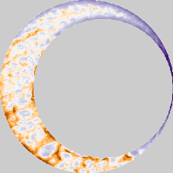
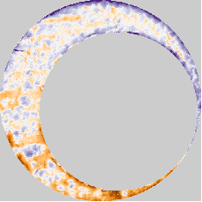
CMC Pipeline Experimentation
In what order should the pieces be arranged?
What is effect of adding/removing a piece of the pipeline?
preProcess_crop() %>%
Cartridge Cases %>%
preProcess_removeTrend() %>%
comparison_allTogether() %>%
decision_CMC()
preProcess_gaussFilter() %>%
Trend Removed
Trend Not Removed
Scan 1
Scan 2
Scan 1
Scan 2
Notes:
For example, what happens if we skip the step where the trend is removed?
The figures below show the same pair of scans.
On the left, the global “tilt” or trend in the scans is not removed causing some values near the top-right to be lower, on average, than values in the bottom-left
On the right, this “tilt” has been removed.

Slide 10
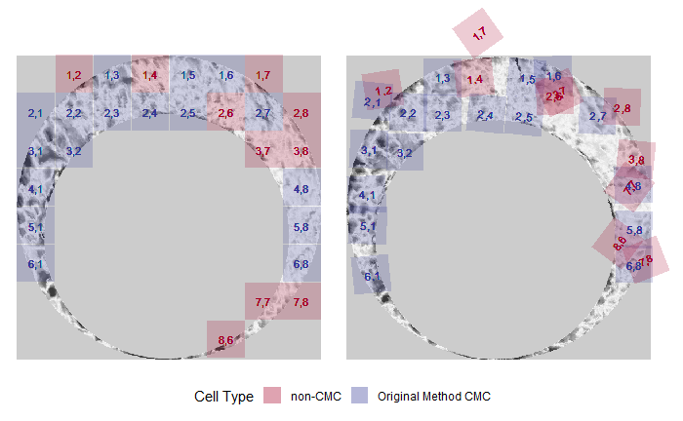
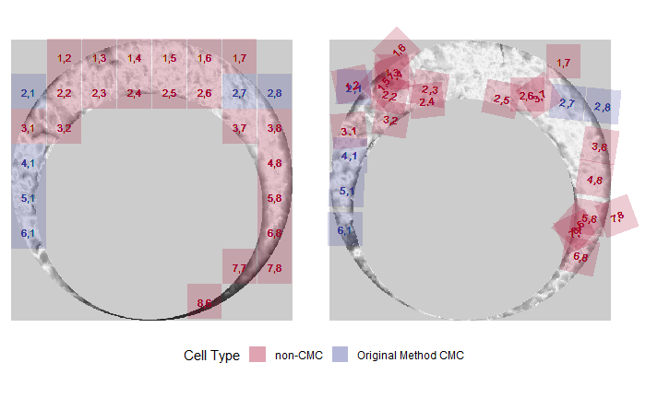
Example: How does removing the trend affect the CMC score?
Trend Removed
Trend Not Removed
Scan 1
Scan 2
Scan 1
Scan 2
Scan 1
Scan 2
Scan 1
Scan 2
17 CMCs
6 CMCs
Conclusion: Removing the trend increases the similarity score for this matching pair.
Notes:
Obviously, a single pair of scans is not sufficient to prove that particular step in the pipeline is warranted.
To justify the addition of a step, we must consider its use across many comparisons.
The next slide shows such results.

Slide 11
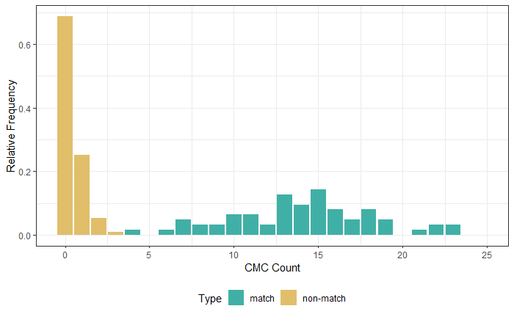
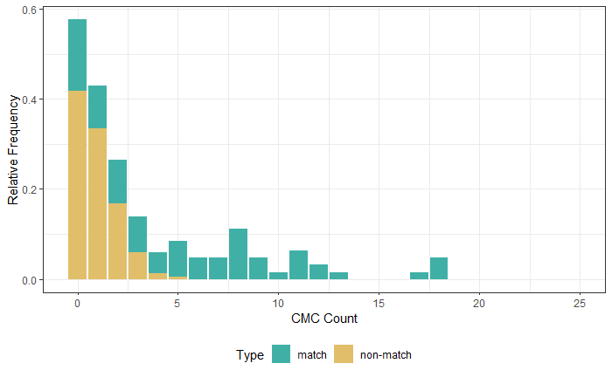
Example: How does removing the trend affect the CMC score?
What is the effect across many comparisons?
Consider 63 matching and 717 non-matching pairs:
Conclusion: Removing the trend improves the ability to differentiate between these matching and non-matching comparisons.
Trend Removed
Trend Not Removed
Notes:
The results shown here indicate that removing the “tilt” to scans increases the CMC score for matching comparisons while decreasing the CMC score for non-matching comparisons, which is desired.
As such, these results suggest that removing the trend is a valuable addition to the overall pipeline.
This demonstrates how the modularization of the CMC algorithms makes experimentation easy

Slide 12
Conclusion
The cmcR package provides a flexible, open-source pipeline.
Open-source algorithms encourage reproducibility of results.
Experiments can be performed faster and by more people.
Reproducibility and experimentation are required to establish error rates and achieve community-wide acceptance.

Slide 13
Resources
cmcR Source Code: https://github.com/CSAFE-ISU/cmcR
Email: jzemmels@iastate.edu
NIST Database: https://tsapps.nist.gov/NRBTD/
An Introduction to R: https://intro2r.com/
R for Data Science: https://r4ds.had.co.nz/

Slide 14
References
Song (2013)
Fadul et al. (2011)
R Core Team
cmcR package
An Introduction to R
R for Data Science

Slide 15
Thank You!
Questions?

